Slide 1


face mask detection system
MINOR PROJECT :
KUIREN VARGHESE C047
ADITYA MAHESHWARI C054

Slide 2
BACKGROUND
Novel human coronavirus disease COVID-19 has become the fifth documented pandemic since the 1918 flu pandemic.
Throughout 2020, the virus has spread to 219 Countries and Territories with a total of 134M confirmed cases of the coronavirus COVID-19 and a death toll of 2.9M deaths.
COVID-19 spreads mainly from person to person through respiratory droplets.
According to the WHO, one of the most effective methods of preventing the spread of the virus.

Slide 3
MOTIVATION AND SCOPE
“To prevent the hardship of this last year from happening again, pandemic preparedness must be taken as seriously as we take the threat of war.” - Bill Gates.
Several countries, including India, have made wearing masks in public compulsory.
Maintaining hygiene and using protective equipment has become even more important ahead of the reopening of religious places, malls, and restaurants in India.
This motivated us to create a the COVID-19 Mask Detector to help ensure your safety and the safety of others

Slide 4
PROBLEM STATEMENT
“The COVID 19 pandemic has spread globally at a rapid rate. Wearing masks have proved to be an effective and crucial method of prevention in battling the spread of this virus and various other viruses. In this project, we aim to create a face mask detection system in Python, using machine learning, neural networks and computer vision. We further implement this output onto an Arduino Uno to give an audio alert(via a buzzer) and a visual output (via a LED). By doing so we hope to create a face mask detection and alert system that can help curb the spread if the virus and promote COVID appropriate behavior in the future.”

Slide 5
LITERATURE SURVEY
Prototype for Integration of Face Mask Detection and Person Identification Model – COVID-19
01
Face Mask Detection Using MobileNetV2 in The Era of COVID-19 Pandemic
02
Implementation Of Tensorflow And Caffe Frameworks: In View Of Application
03
Face Mask Detection Using MobileNetV2 in The Era of COVID-19 Pandemic
04

Slide 6
METHODOLOGY
There are two distinct phases :
Training: Here we focus on loading our face mask detection dataset from disk, training a model (using Keras/TensorFlow) on this dataset, and then serializing the face mask detector to disk.
Deployment: Once the face mask detector is trained, we can then move on to loading the mask detector, performing face detection, and then classifying each face as with_mask or without_mask using the webcam.

Slide 7
FLOWCHART
Load face mask dataset
Train face mask classifier with Keras/Tensorflow
Serialize face mask classifier to disk
Building the model
Detect faces on video stream
Extract each face ROI
Apply Face mask classifier to each face ROI to determine "Mask" or "No Mask"
Integrate Arduino code in python
Show results on the screen and on Arduino

Slide 8






SOFTWARES AND LIBRARIES USED

Slide 9
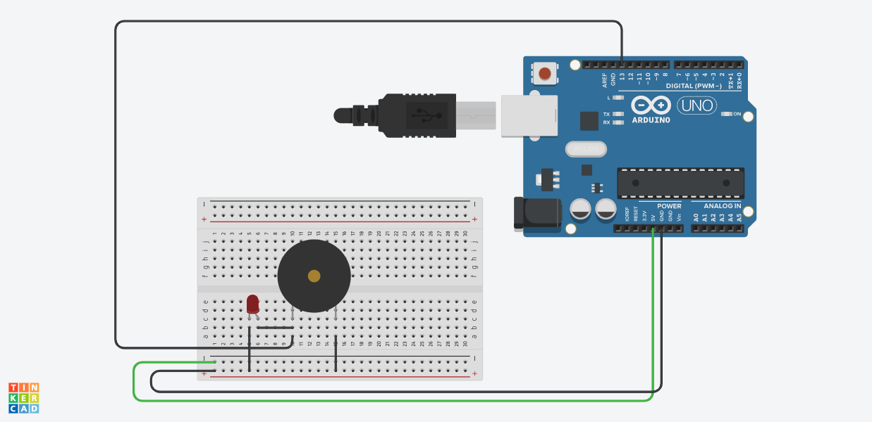
ARDUINO CONNECTION

Slide 10
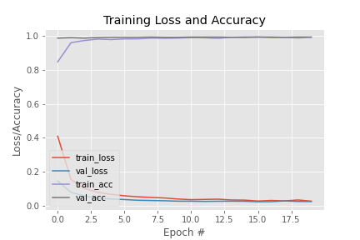
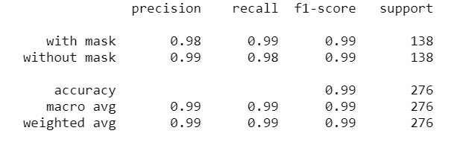
EVALUATION METRICS

Slide 11

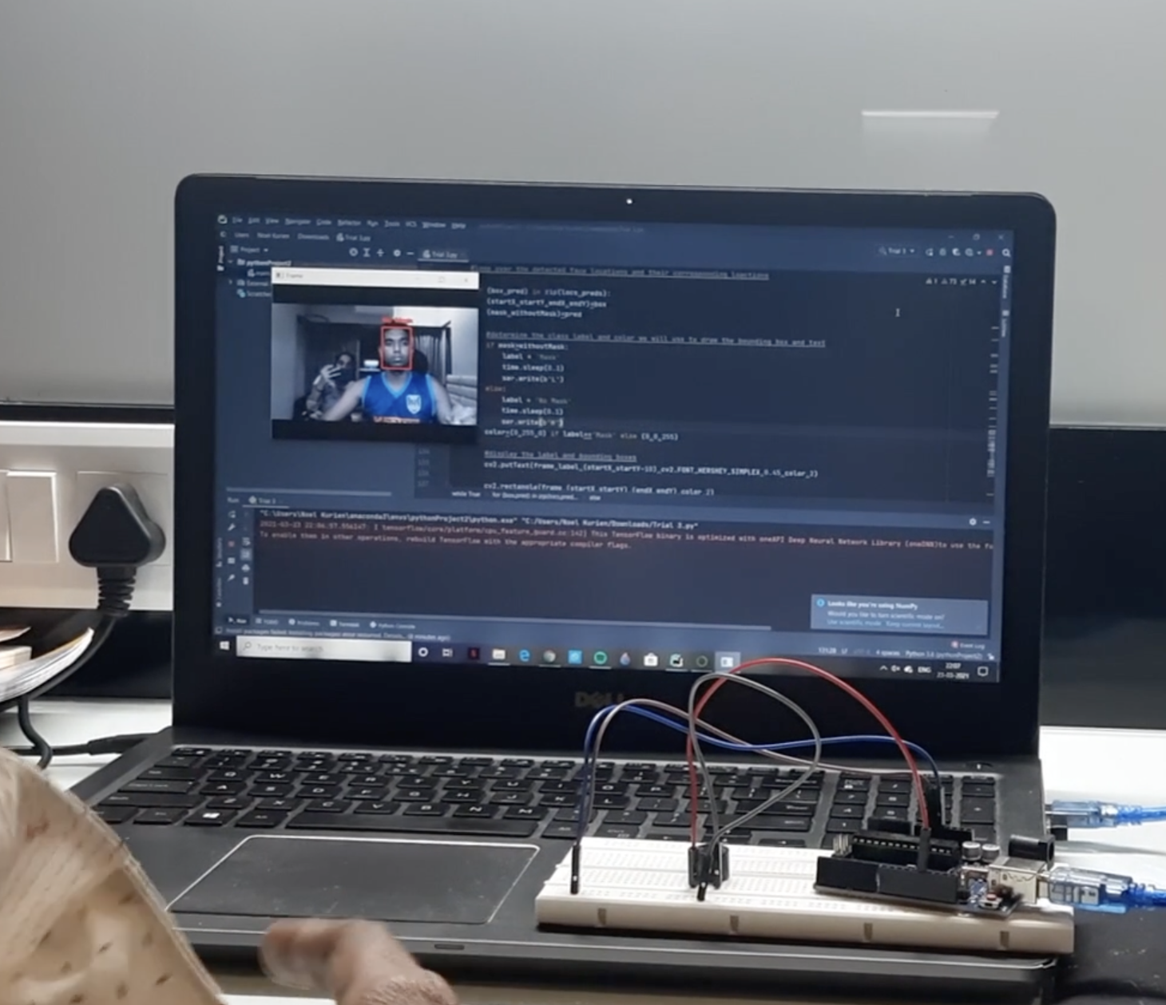
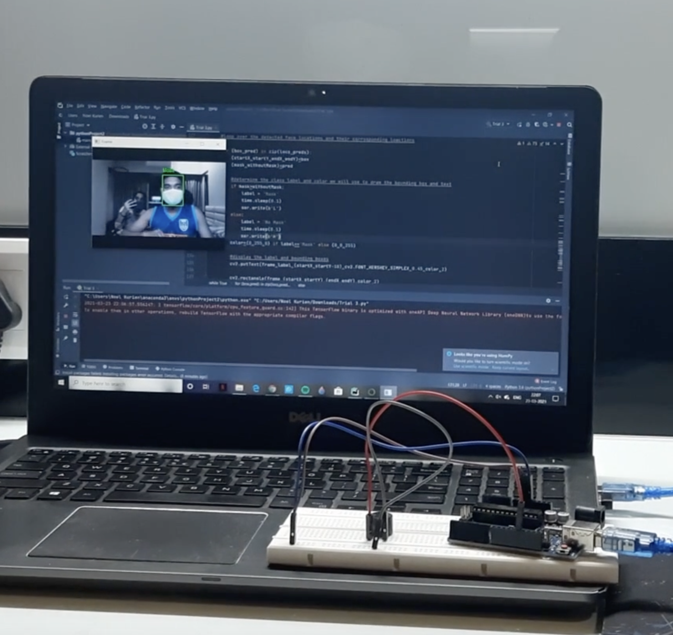
WORKING PROTOTYPE OF THE PROJECT

Slide 12
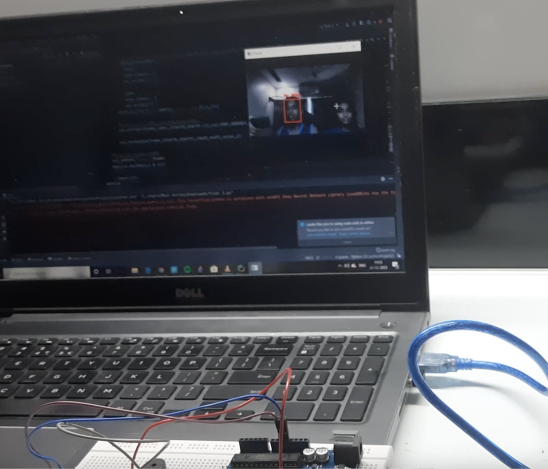
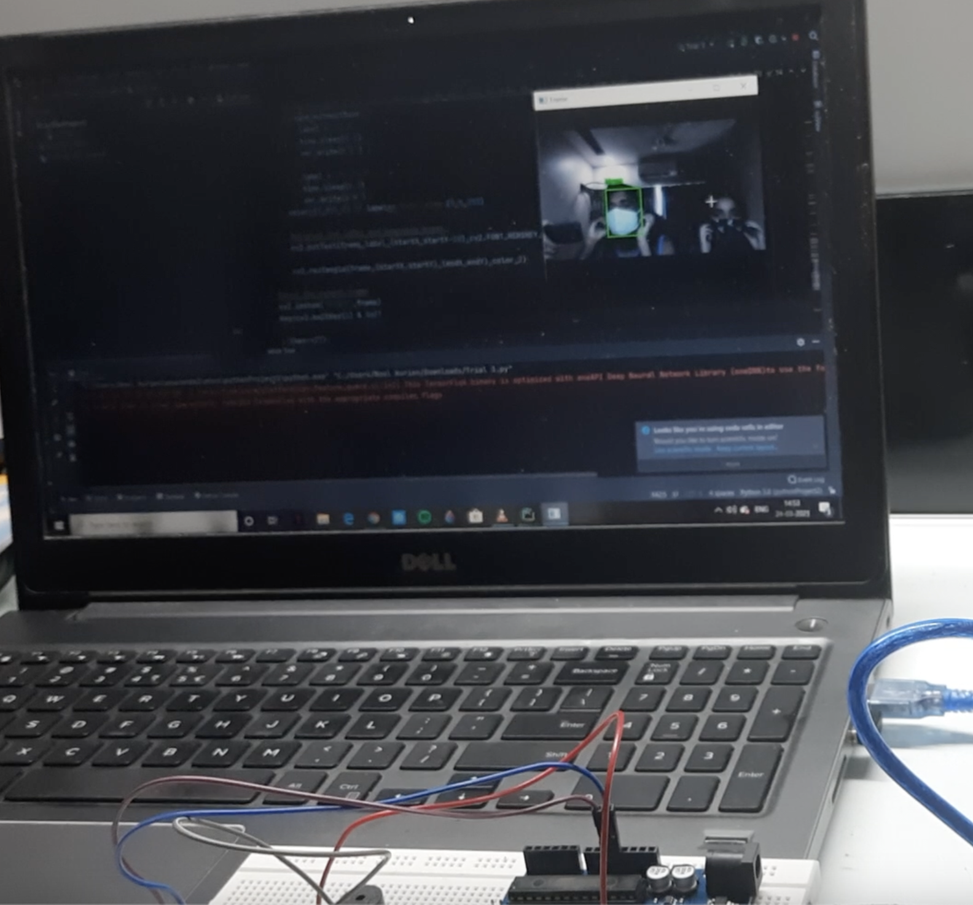
With 2 people in the frame

Slide 13
CONCLUSION
We fine-tuned MobileNetV2 on our mask/no mask dataset and obtained a classifier that is 99% accurate.
We then took this face mask classifier and applied it to both images and real-time video streams by:
Detecting faces in images/video
Extracting each individual face
Applying our face mask classifier
Our face mask detector is accurate, and since we used the MobileNetV2 architecture, it’s also computationally efficient, making it easier to deploy the model to embedded systems (Raspberry Pi, Google Coral, Nano, etc.).

Slide 14
THANK YOU

